Slide 1
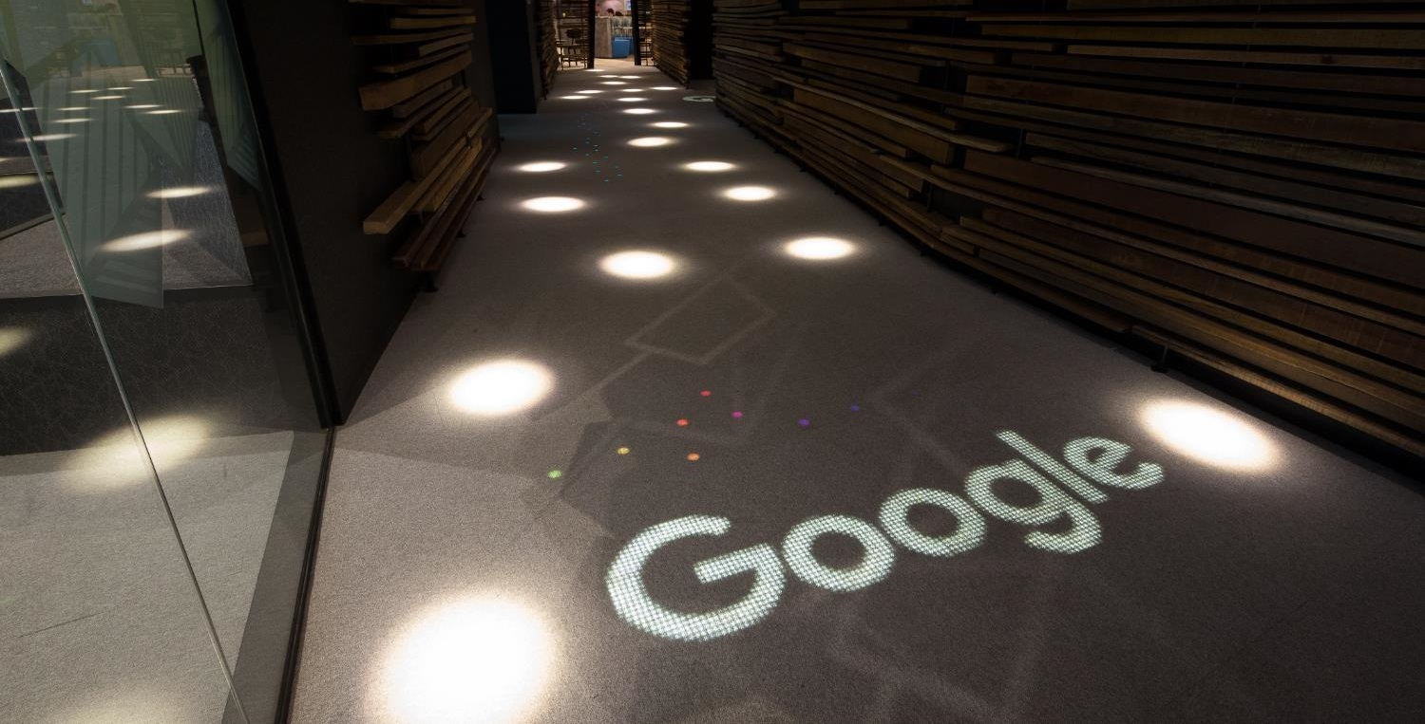
Luminous flooring
A unique new way to interact with people

Slide 2
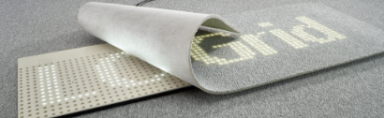
Luminous flooring
We believe a great customer and guest experience
increases loyalty and is essential for success.

Slide 3
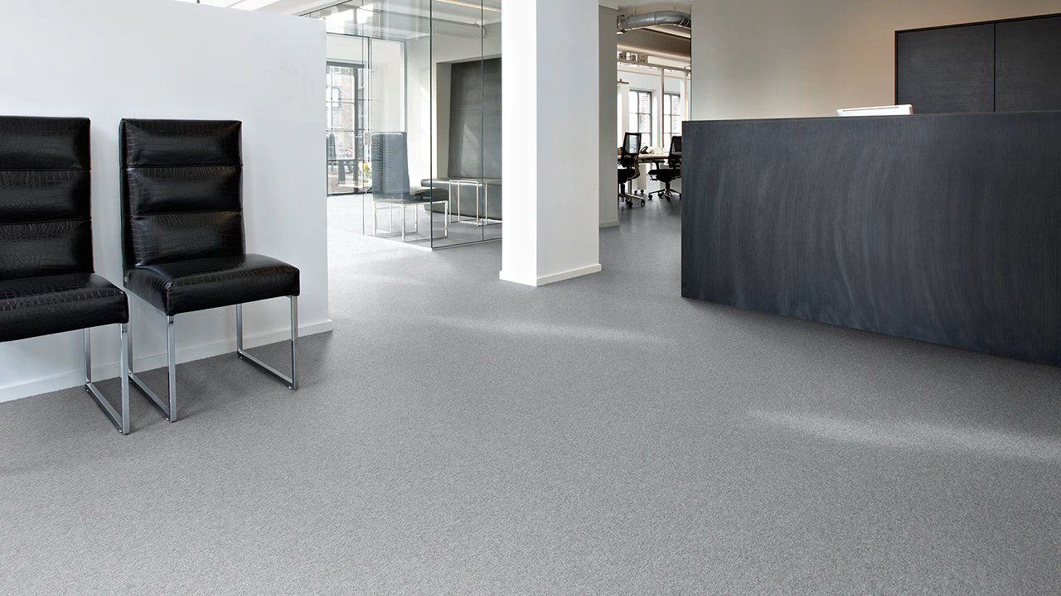
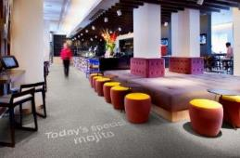
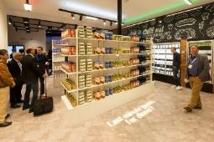
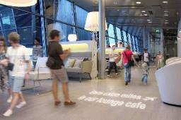
Application areas
Offices
Hospitality
Retail
Public Spaces
Make people feel welcome
Impress your guests
Guide your visitors
Provide information
Guide your guests
Create a personal welcome
Enhance brand experience
Increase safety
Advertising
Promotions
Personal welcome
Guiding in the store
Crowd control
Wayfinding
Advertising
Announcements
Mainly with carpets
Mainly with vinyl flooring

Slide 4
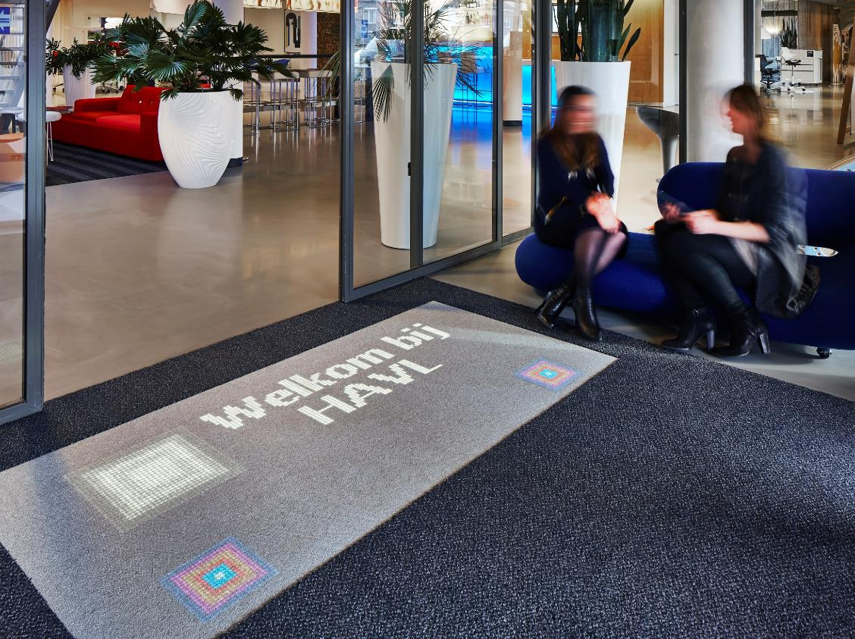
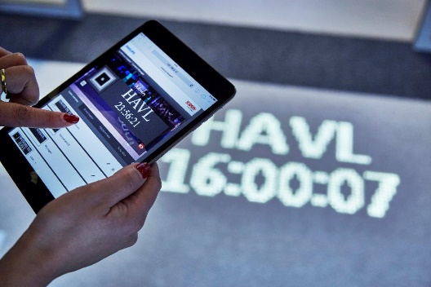
Branded welcome in Tilburg, Netherlands

Slide 5
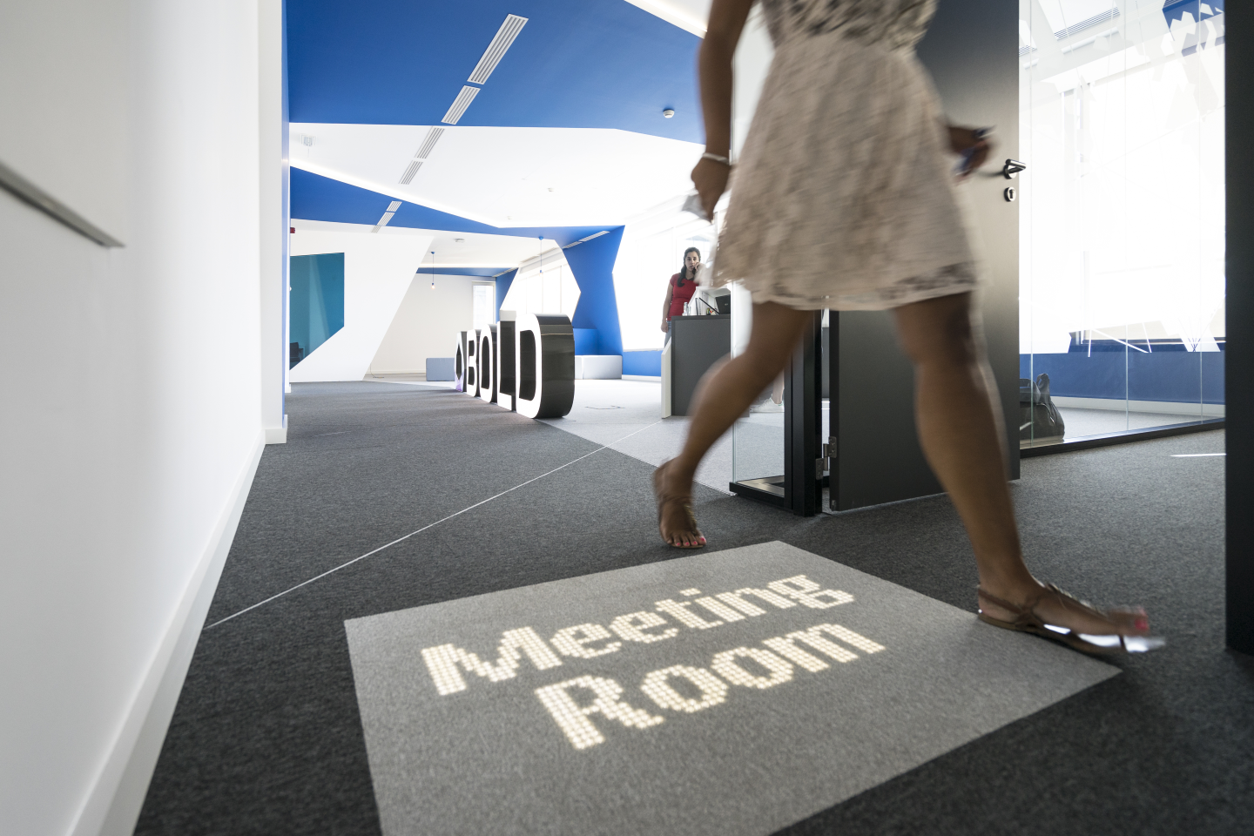
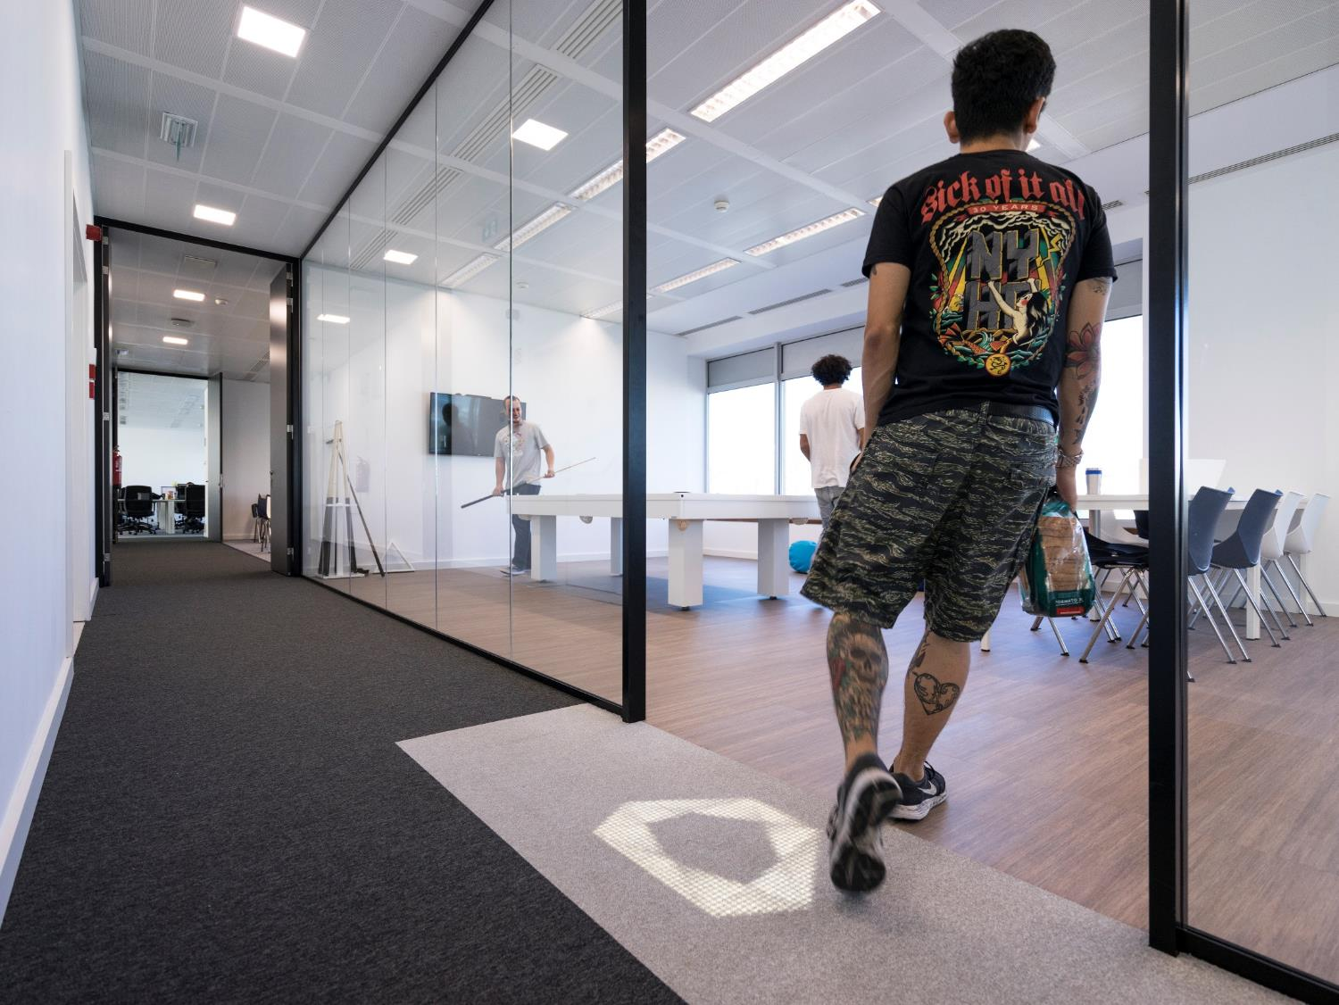
Guiding at Bold, Portugal

Slide 6
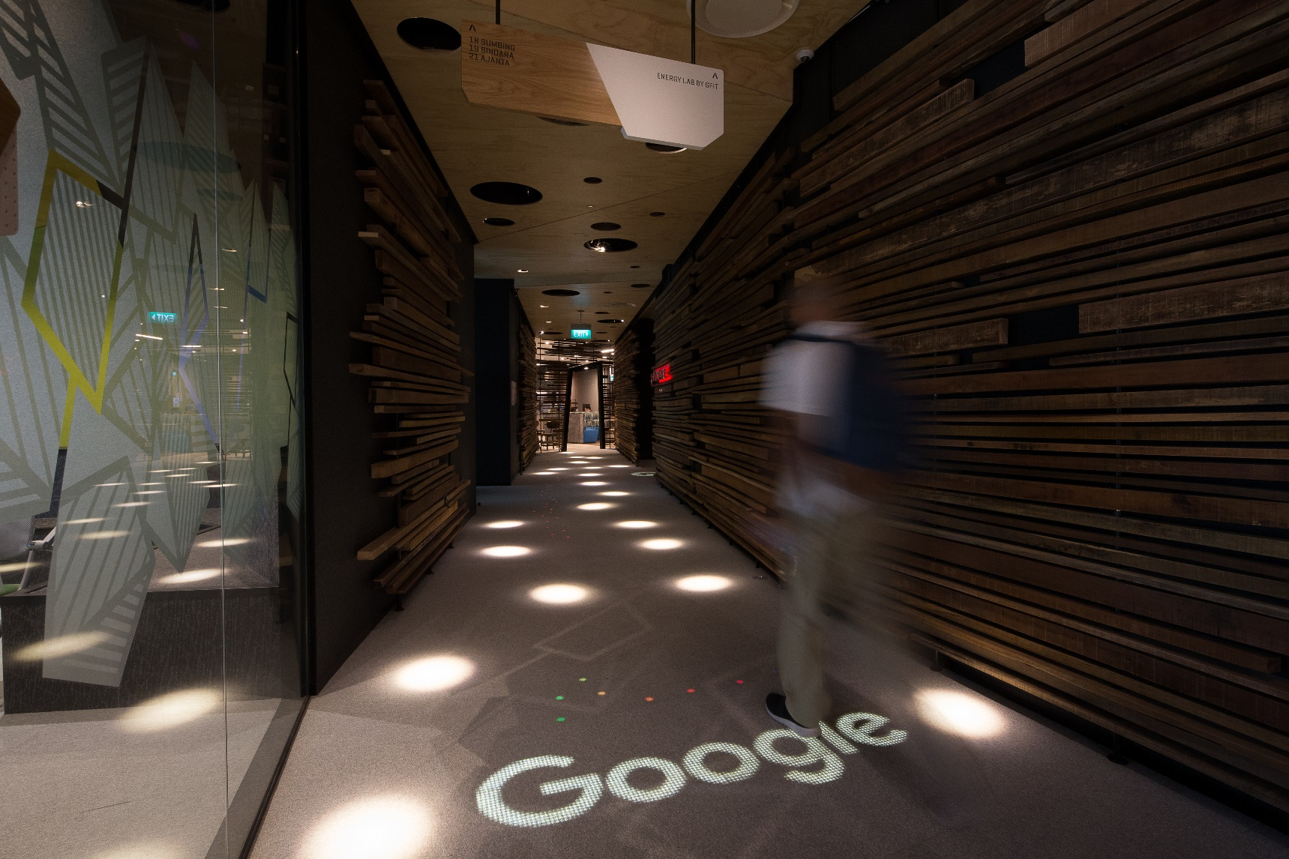
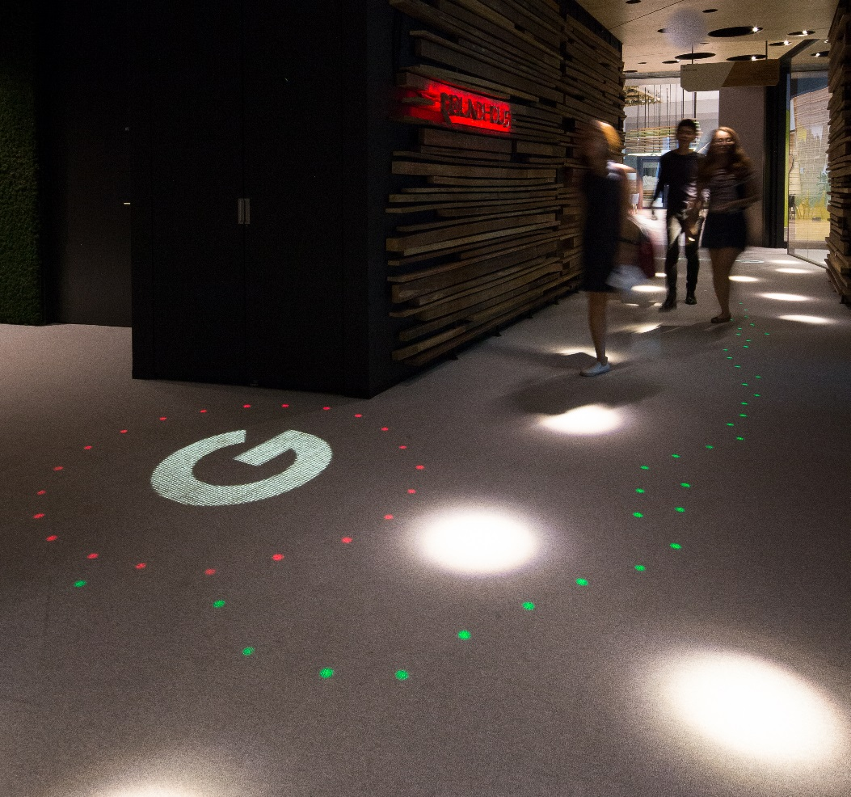
Branded welcome at
Google, Singapore

Slide 7
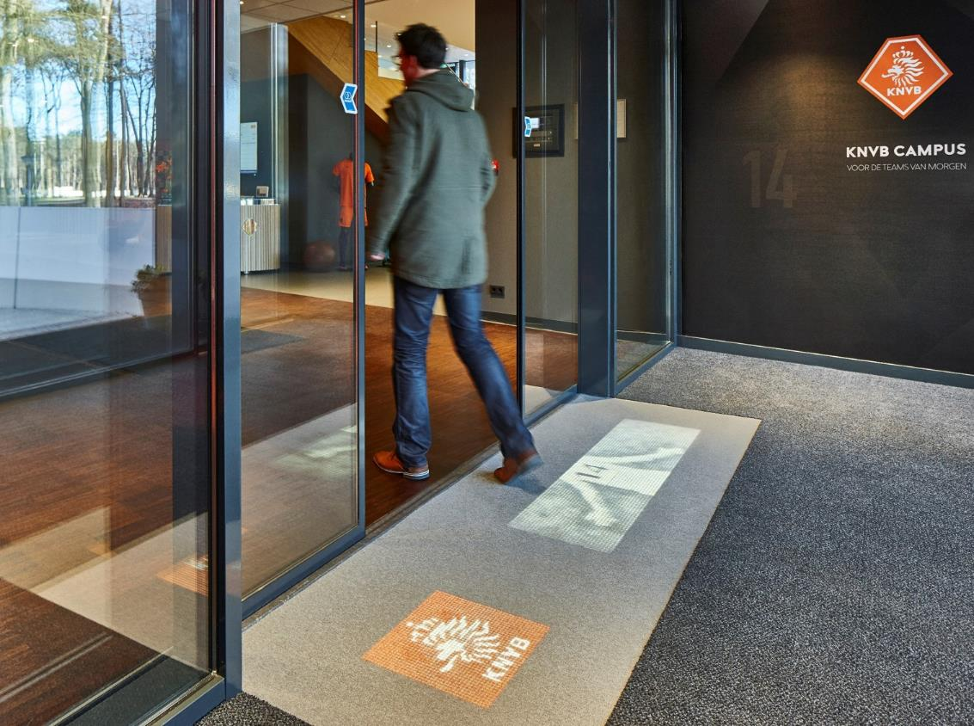
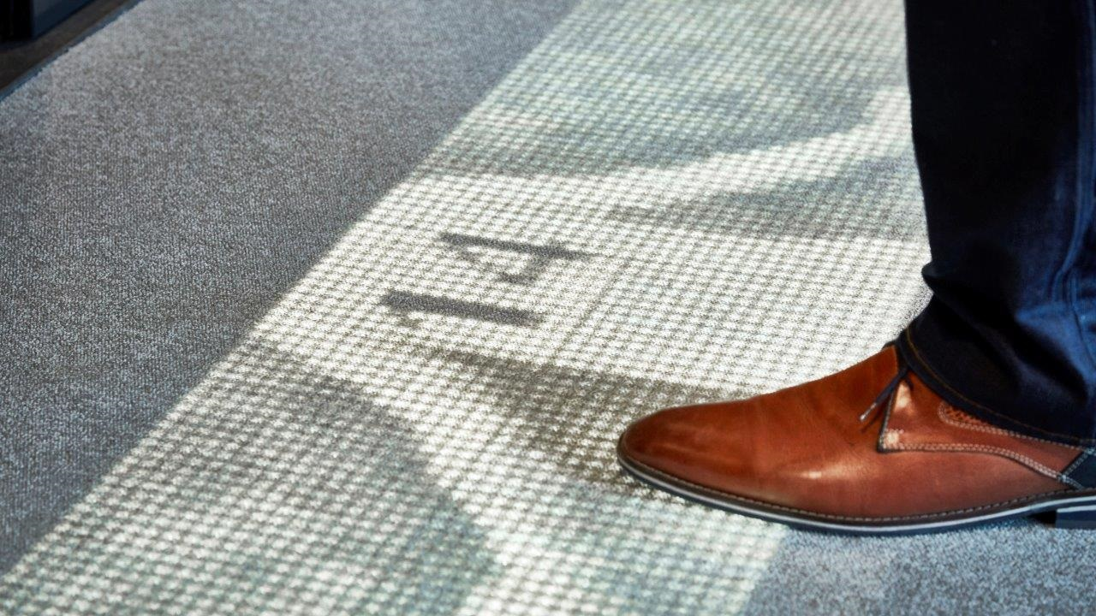
Branded welcome
at KNVB, Netherlands

Slide 8
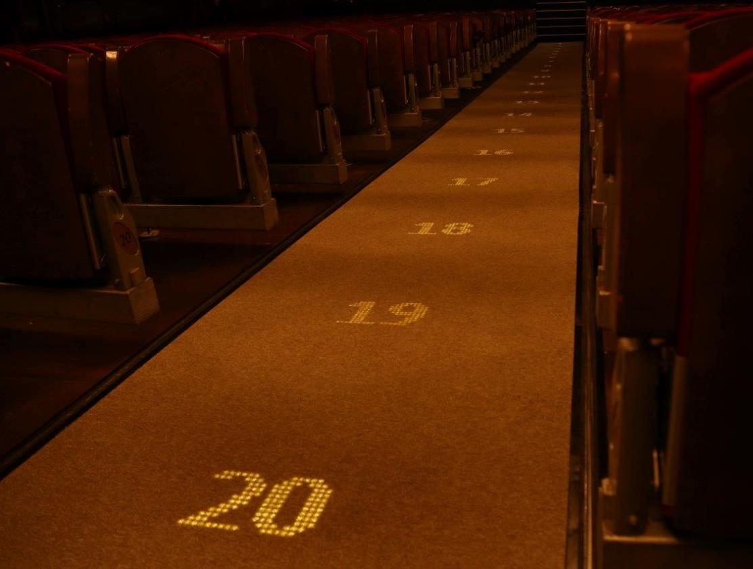
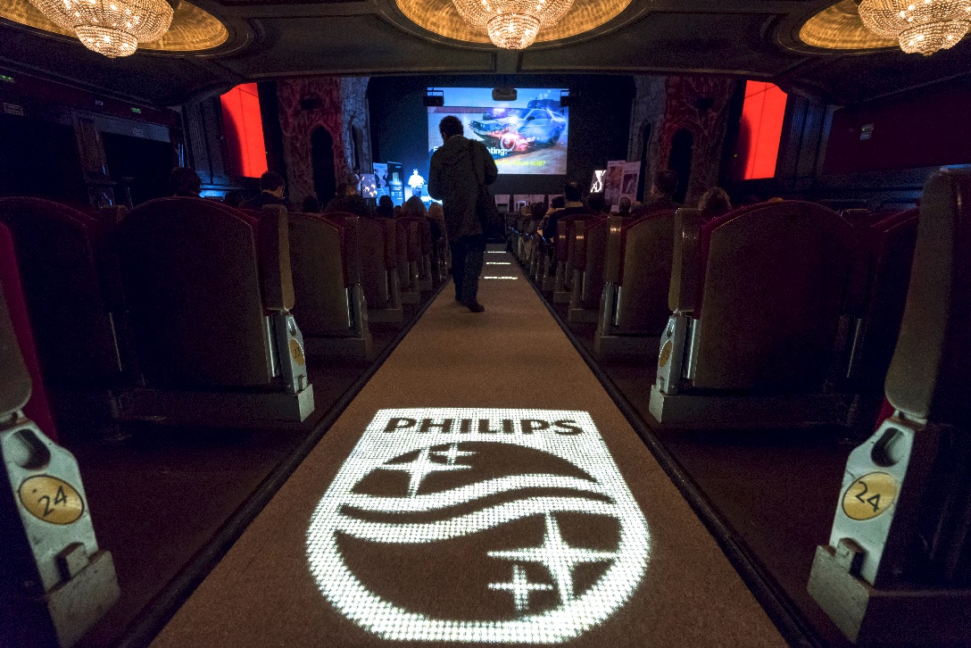
Where is my seat?
Teatro Madrid, Spain

Slide 9
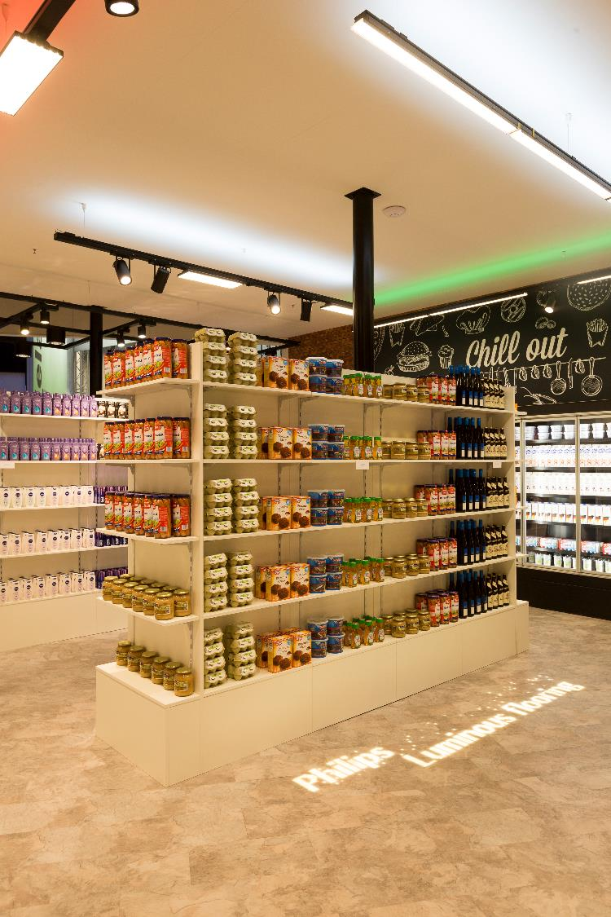
Luminous vinyl flooring
Enables the broadcast of luminous
messages, animated advertisement and promotions on the vinyl floor.
  To provide unique customer
  experiences and help drive sales

Slide 10
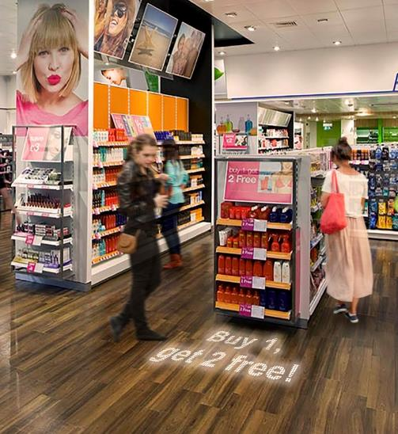
In-store promotions

Slide 11
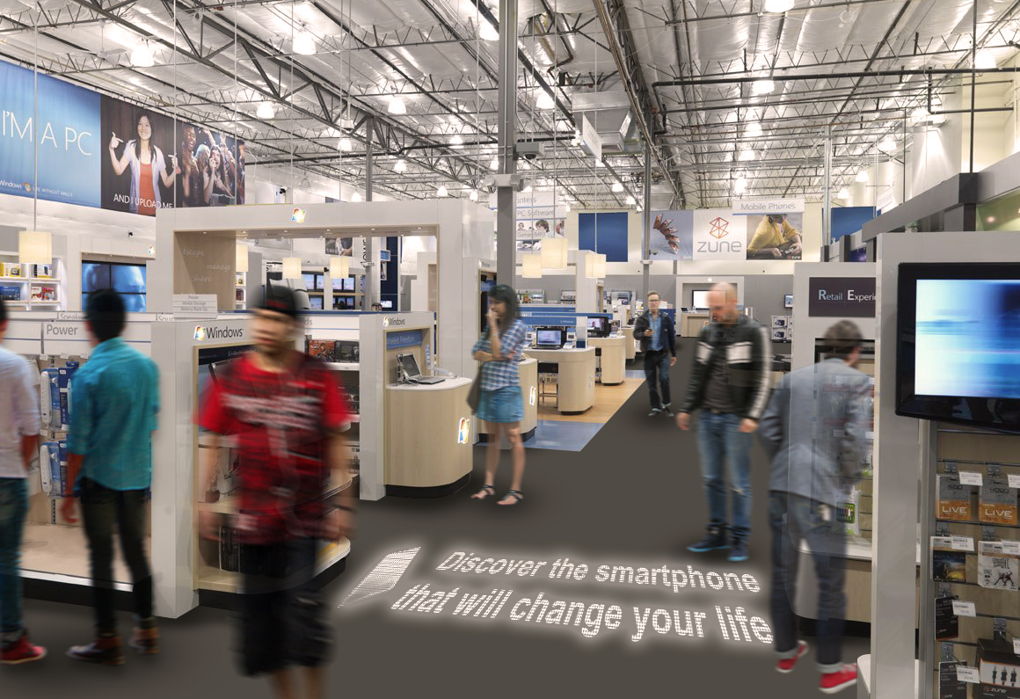
In-store advertisement

Slide 12
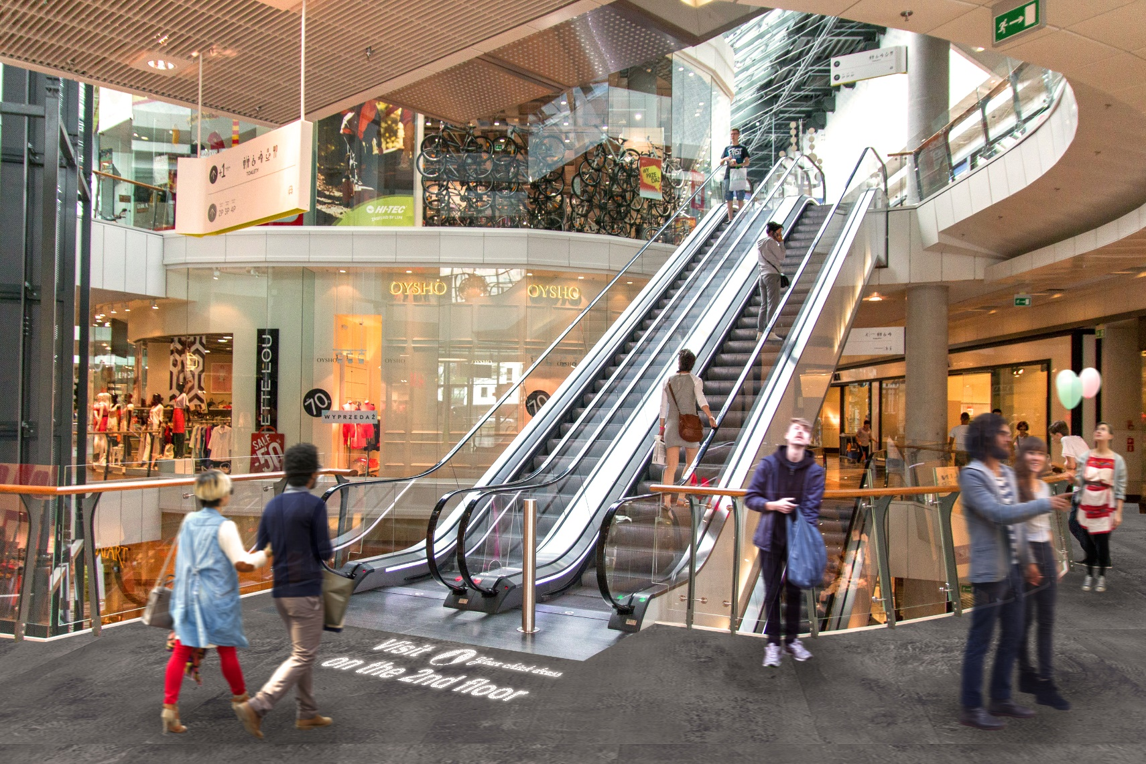
Shopping mall – commercial wayfinding

Slide 13
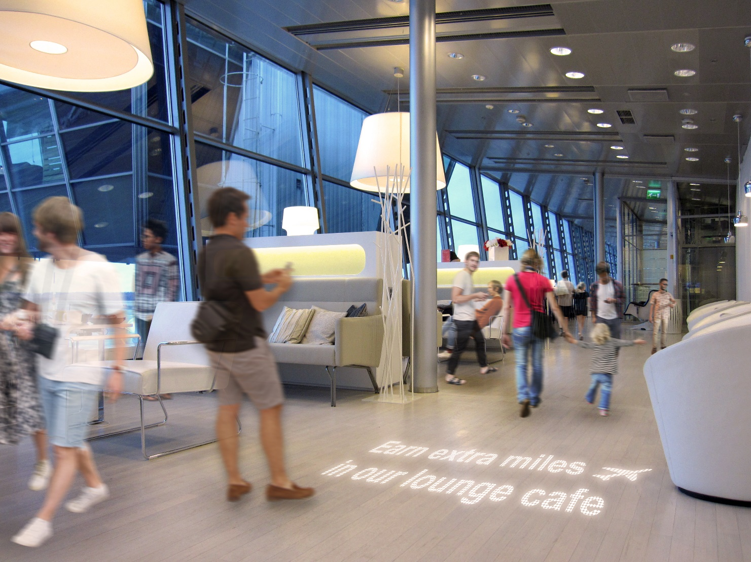
Public spaces – announcement, crowd control, wayfinding, promotions, advertisement

Slide 14

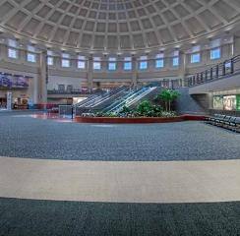
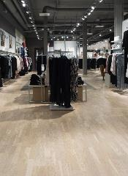
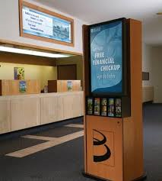
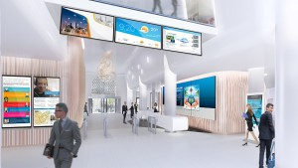
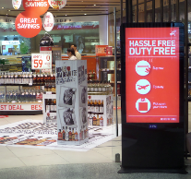
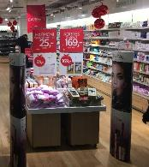
Flooring offers a great opportunity to display messages and animations
VS
Notes:
We can make much more use of the floor, instead of putting things on the floor or hang items at ceilings

Slide 15
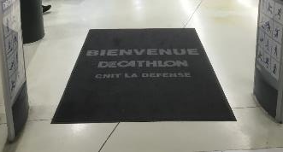

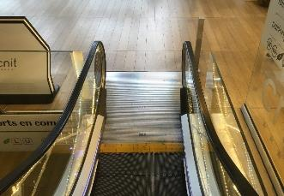
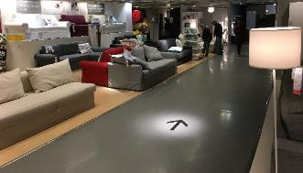
Floor is a fantastic location to communicate
At the entrance of a venue
To attract attention of visitors looking
at their smartphones
In locations where floor
is naturally overlooked
For guiding purposes

Slide 16
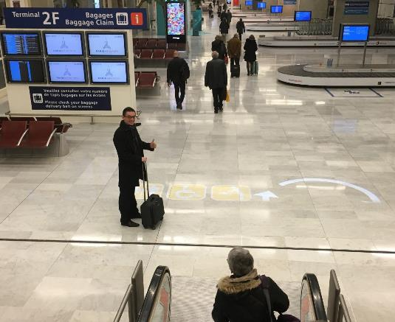
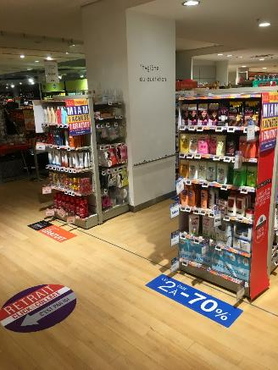
Existing solutions show several drawbacks
Projectors
- project the light on the floor surface
- create shades hiding the content when there is traffic
- are not bright enough in spaces with high ambient light
Stickers
- show only a static message
- get soiled quickly
- can damage the flooring

Slide 17
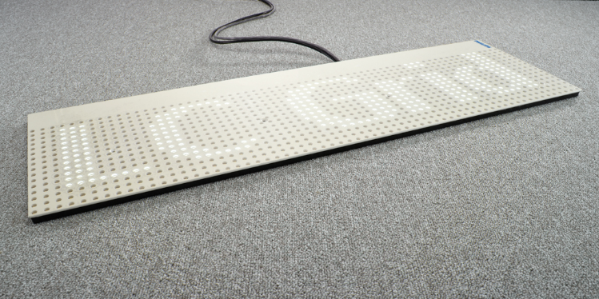
Our product portfolio

Slide 18
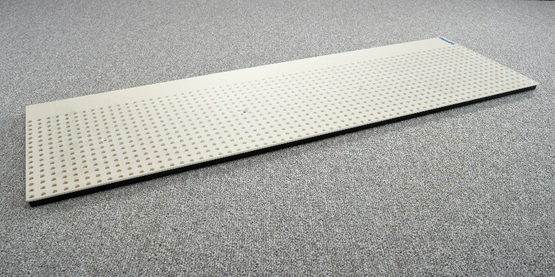


LC Grid: our dynamic solution
LC Grid
Super-thin LED panel:12 mm
LED-lit area: 3 available sizes: 20 x 80 cm, 20 x 20 cm and 40 x 40 cm
Dynamic text and images
Web based content manager to be used with tablet, laptop or pc
Stackable to create a larger lit area
Content Manager
Cloud connection (optional)
Accessible wireless via web browser
(PC, Tablet, Smartphone)
Instantly check the content on the floor
Address each (segment of) panel individually
Create playlists, schedule content
Upload images
Refresh content remotely
Broadcast to multiple sites
Remote troubleshooting and diagnosis
Seamless updates
Safe communication thru cloud server

Slide 19
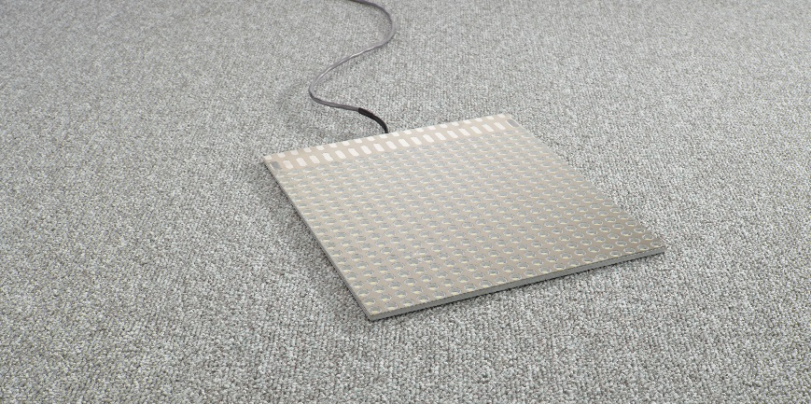


LC Symbol: our smallest solution
LC Symbol
Fixed content
White LEDs
Color filter and fading effect optional
Stackable to create larger surfaces
LC Symbol custom icon or logo
Ultra-thin LED panel: 5 mm
LED-lit area: 20 x 20 cm
Custom designed static logos and icons
Color filter and fading effect optional
Stackable to create larger uninterrupted surface
LC Symbol pre-defined icon
Ultra-thin LED panel: 5 mm
LED-lit area: 20 x 20 cm
Static icons: choose from our list
(see LC Symbol datasheet)
Fading effect optional

Slide 20
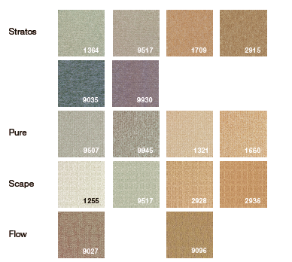
Product: carpet
Special carpet tiles designed and required
for this application (special carpet only required on illumination)
Unique light transmissive capacity
R&D protected by multiple IP patents
The carpet is designed for commercial areas
and high traffic locations
Light colors and low pile height allow for best distribution of light
*
* Only on lower light levels

Slide 21
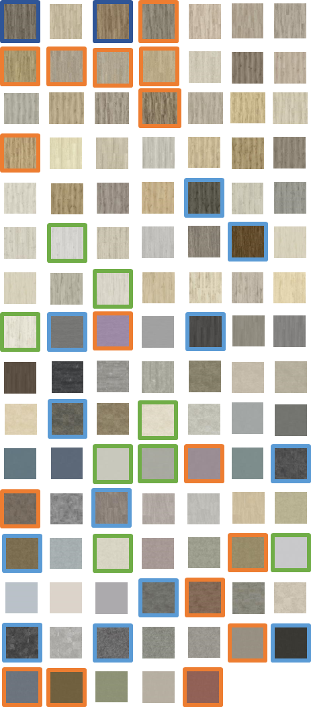
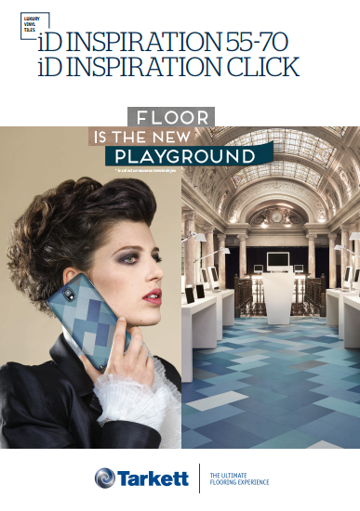
Vinyl flooring range
Luminous vinyl flooring can be combined
with normal vinyl flooring
Base range is iD Inspiration from Tarkett (110 colors)
  95 available
  15 darker colors require case by case acceptance
  Sizes available:
    No restriction on planks (wood finishes)
    Non-wood, 25x50 or 33,33 x 61 cm
  Some versions of iD Inspiration will create a orange
  light effect
Custom flooring on request
Luminous vinyl flooring is only available in the
standard glued version (not with click and not loose lay)
*All binding quotations require approval by core team

Slide 22
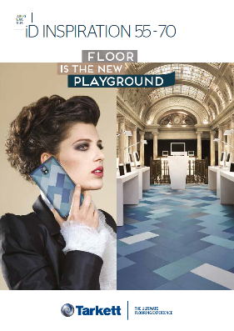
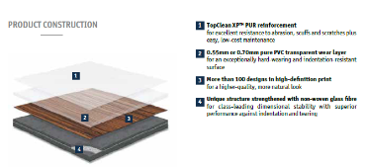
Vinyl flooring tiles – regular tiles main characteristics
Tarkett iD Inspiration 55-70 vinyl tiles collection
110 designs (Woods, Authentic Stones, Material Effects, Design Effects)
Total thickness 2,5 mm
Available in 0,55 mm and 0,70 mm wear layers
Various tile formats available
  planks for wood designs, typically 20x122 cm
  slabs for stone and other designs, typically 50x50 cm
Designed for commercial areas and high traffic locations
Excellent resistance to abrasion and scratches
Simplified cleaning and maintenance thanks to unique surface treatment
10 years limited guarantee for commercial use
Standard version is glued, other collection exist with click or loose lay
Low VOC emissions contribute to better indoor air quality
Cradle to Cradle (made from 36% recycled material, 100% recyclable)
Fully customizable collection
  color change (minimum 1 500 sqm order)
  tile format change (min 700 sqm)
  embossing/surface structure change (min 1 100 sqm)
  several beveling options available (no min)
  custom design can also be discussed

Slide 23


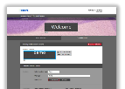


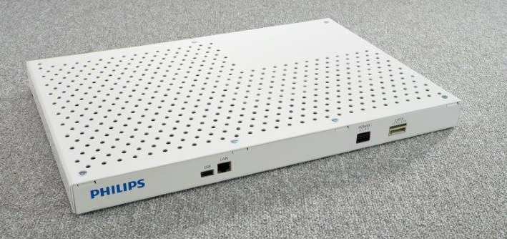
Example system/controls set-up
2x LC Grid
Network
PC/Server
17 inch
216 mm
Ethernet Switch
31,5 inch
800 mm
LC Grid Controller
LC Grid Controller

Slide 24
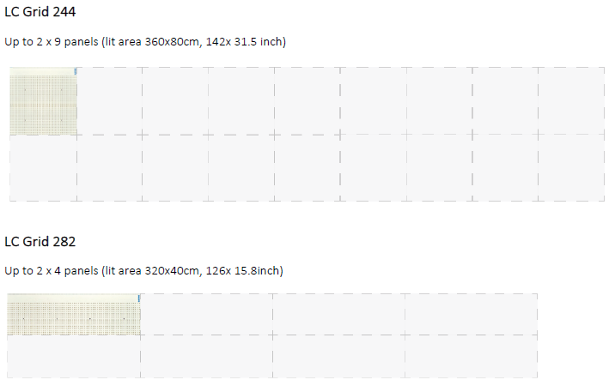
Products – LC Grid configurations

Slide 25
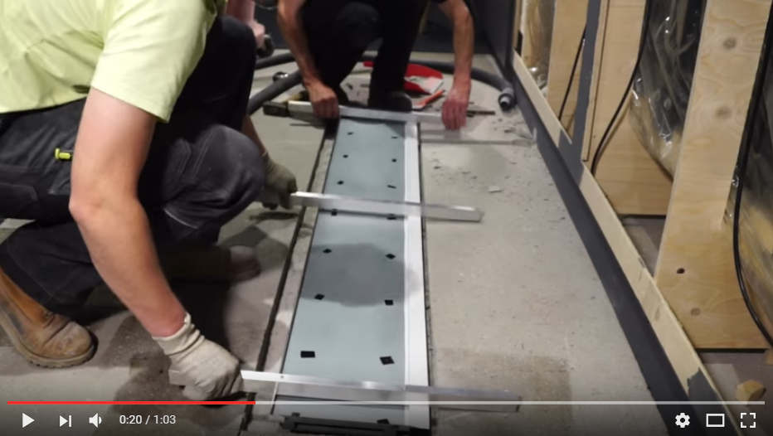
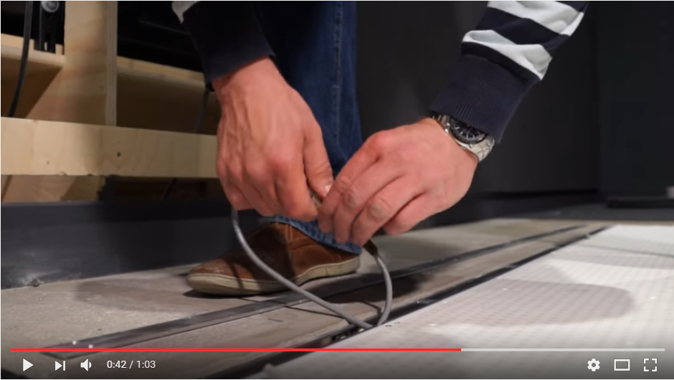
Floor installation
Three different types of floor installations
- raised access,
- recessed,
- on-top
Philips or partner does pre-commissioning and commissioning on site
Local general contractor takes care of any required floor work, electrician for the cabling
Tarkett works with a network of vinyl installers to install the vinyl
Installation video available online

Slide 26
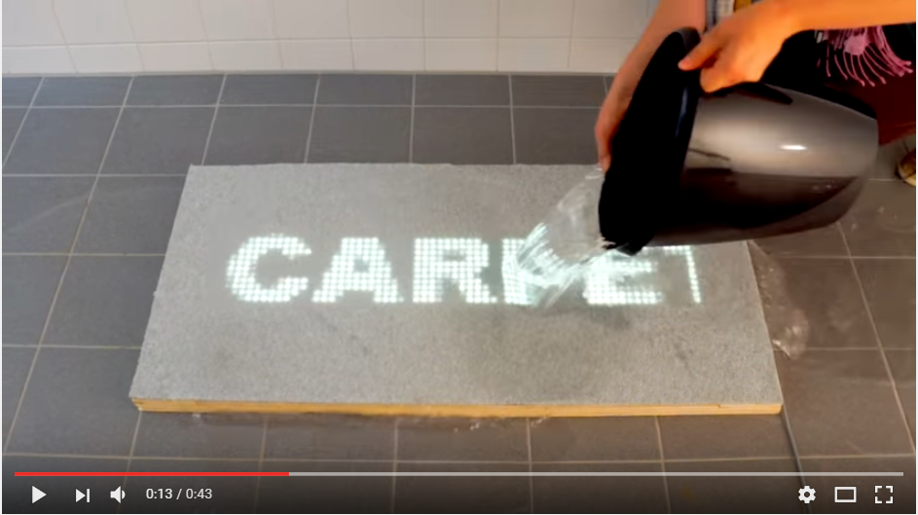
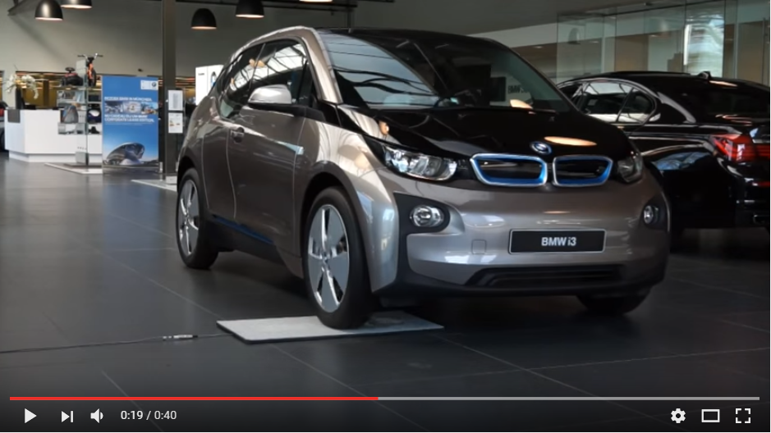
Frequently asked…
Are the LED units resistant to spilling water or other fluids
  → Watch our video on you tube
Are the units protected against heavy loads
  → Watch our video on Youtube

Slide 27


